Slide 1

Chapter 2
The Evolution of Humanity and Culture
Notes:
For a better classroom presentation flow, the order of some topics in this lecture outline differs slightly from the order of topics in the text and, where this occurs, some figures and tables are out of numerical order.

Slide 2
Learning Objectives
  2.1 Identify what living nonhuman primates tell us about human culture.
  2.2 Illustrate the role of culture during hominin evolution.
  2.3 Summarize how modern human culture has changed in the past 12,000 years.

Slide 3
Nonhuman Primates and the Roots of Human Culture 2.1 Identify what living nonhuman primates tell us about human culture.
Primate Characteristics
The Great Apes
Nonhuman Primate Culture

Slide 4
Primate Characteristics (1 of 5)
Primates are an order of mammals that includes modern humans
Vary in size from several ounces to over 400 pounds
Some inhabit limited areas; others range more widely

Slide 5
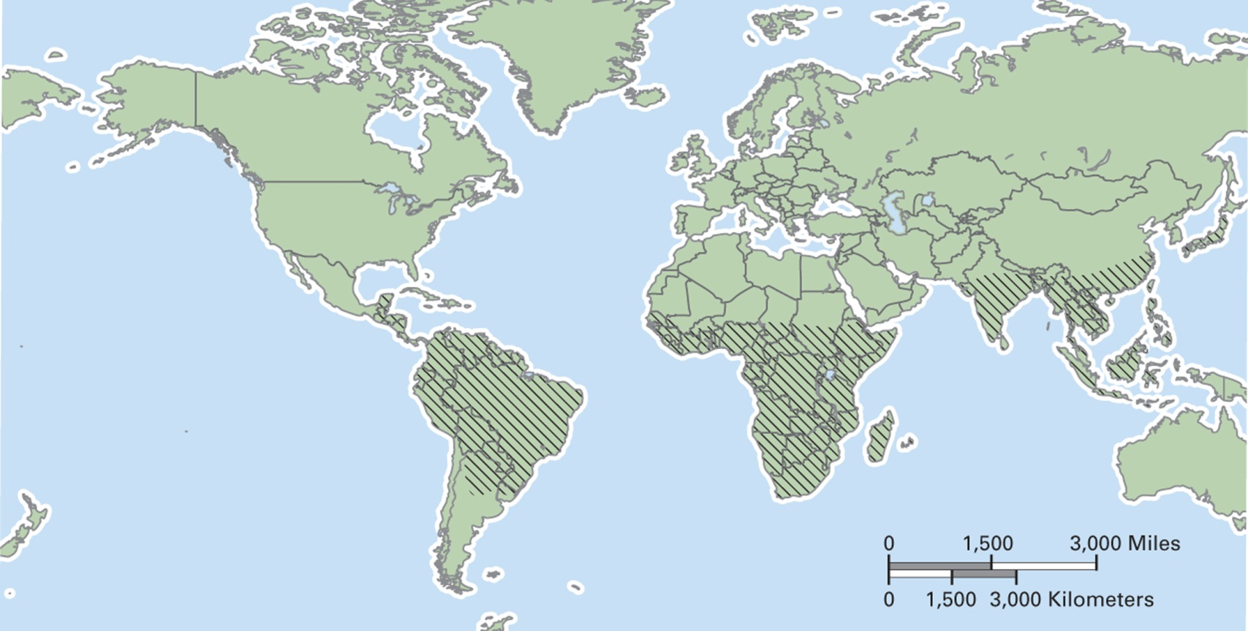
Map 2.1 Where Nonhuman Primates Live Today

Slide 6
Primate Characteristics (2 of 5)
Faces tend to be flat with reduced snouts
Highly reliant on vision
Have five digits on hands and feet and can grasp with both
Large brains in relation to body size

Slide 7
Primate Characteristics (3 of 5)
Most primate species are arboreal (tree-dwelling)
Quadrupedal (moving on all fours)
Diurnal (active during the day)
Highly social

Slide 8
Primate Characteristics (4 of 5)
Frugivores eat mainly fruit
Folivores eat primarily leaves
Insectivores eat mainly insects
Gummivores rely on gums and saps of trees
Omnivores are generalists; many kinds of foods make up their diet

Slide 9
Primate Characteristics (5 of 5)
Most common social group: multi-male/multi-female (MM/MF)
Rare pattern: fission-fusion group
  Large group that breaks up into smaller subgroups for foraging
  Found in chimpanzees and bonobos
  Early human ancestors may have had this type of social organization

Slide 10
The Great Apes (1 of 5)
Category of large, tailless primates
Locomotion by brachiation
Modern humans and great apes share a common ancestor
All great ape species in the wild are endangered

Slide 11
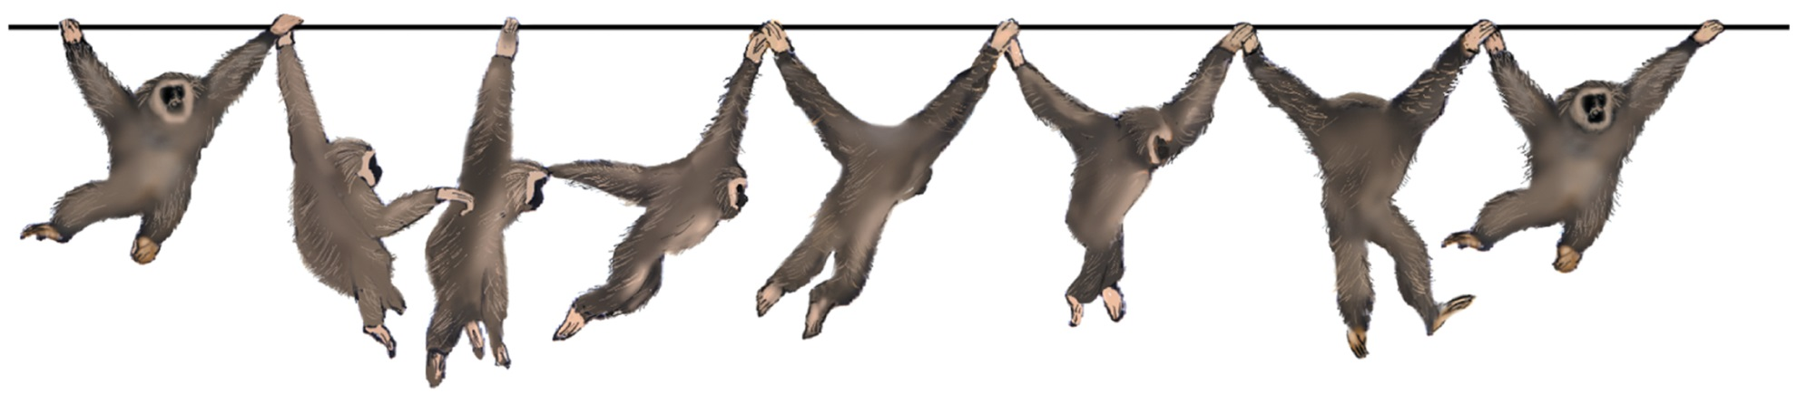
Figure 2.2 Brachiation in Action

Slide 12
The Great Apes (2 of 5)
How the human line diverged:
  Human anatomy evolved with emphasis on habitual locomotion on two legs and larger brains
  Humans developed culture, including verbal language, to a more complex degree

Slide 13
The Great Apes (3 of 5)
Orangutans
  The only Asian great ape
  Live on the islands of Borneo and Sumatra
  Marked sexual dimorphism
  Mainly arboreal
  Frugivores
  Most solitary of great apes
  Make simple tools from branches

Slide 14
The Great Apes (4 of 5)
Gorillas
  Live in sub-Saharan Africa
  Largest of the living primates
  Marked sexual dimorphism
  Eat a wide variety of plants and supplement with termites and ants
  Social groups composed of a single male and multiple females with the females’ dependent offspring
  Live in dense forest and are largely terrestrial
  Quadrupedal and knuckle-walkers

Slide 15
The Great Apes (5 of 5)
Chimpanzees and Bonobos
  Live in sub-Saharan Africa
  Most closely related to humans
  Smaller and less sexual dimorphism than orangutans and gorillas
  More arboreal than gorillas, but knuckle-walkers when on the ground
  Frugivores, but occasionally eat insects, vegetation, and small animals
  Spend 25 percent of time in social interactions, compared with 10 percent for other great apes, except for humans

Slide 16
Nonhuman Primate Culture (1 of 2)
Increasing evidence indicates that animals other than humans have aspects of culture
In primatology, culture is defined as behavior that is learned and shared
Example: Imo, the Japanese macaque

Slide 17
Nonhuman Primate Culture (2 of 2)
Young primates learn various cultural behaviors by watching adults, but invention also occurs
Example: JJ, a young male chimpanzee, transferred his skills at using a stick to retrieve ants on the ground to obtaining them in trees
  Not yet known if JJ’s invention will spread to the group

Slide 18
Anthropology Works:
Saving Orangutans
Lifelong commitment of Biruté Galdikas, primatologist and specialist in orangutans
Importance of educating the public about danger to orangutan survival
Combines deep knowledge with activism on behalf of orangutans
Question: Do researchers have a responsibility to use their knowledge for a cause?

Slide 19
Hominin Evolution to Modern Humans
2.2 Illustrate the role of culture during hominin evolution.
The Early Hominins
Archaic Homo
Modern Humans

Slide 20
The Early Hominins (1 of 13)
Separated from other great apes from 8 million until 3 million years ago
Lived in Africa
Distinct from other apes
  Changes to pelvis and lower limbs to allow for habitual bipedalism
  Larger brains
  Smaller teeth

Slide 21
The Early Hominins (2 of 13)
Two earliest hominin species:
  Sahelanthropus tchadensis
    Dated to between 6 million and 7 million years ago
    Discovery indicates that early hominins occupied a wider area of Africa than previously thought
  Orrorin tugenensis
    Dated to 6 million years ago
    Analysis of femur indicates bipedalism

Slide 22
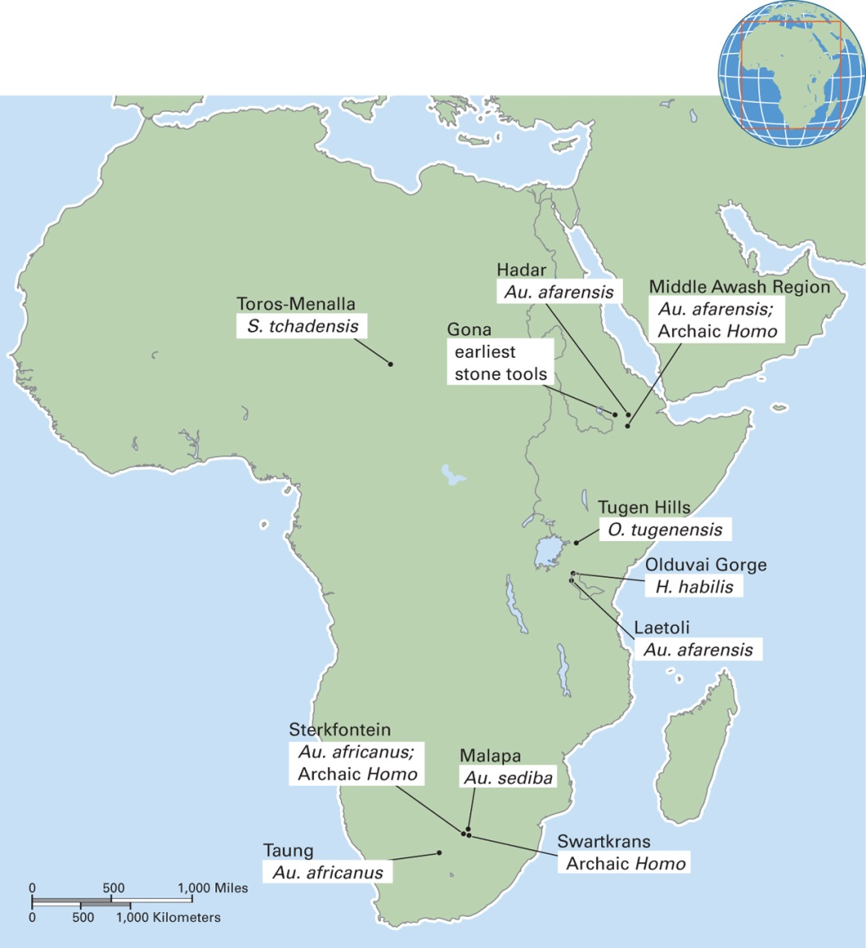
Map 2.3 Sites of Early Hominins and Archaic Homo in Africa

Slide 23
The Early Hominins (3 of 13)
Australopithecines
  Category of several extinct species found in East and Central Africa
  Lived between 2 million and 4 million years ago
  “Lucy” famous because so much of her skeleton was preserved
  Era provides the first artifacts, in the form of stone tools, which indicate culture

Slide 24
The Early Hominins (4 of 13)
Archaic Homo
  Category of hominin species that lived from 2.4 million to 17,000 years ago
  More modern human-like body shape, larger brains, smaller jaws and teeth
  Stone tools are prominent
  Migrated into much of the Old World
  No clear evidence about whether they died out or interbred with later species

Slide 25
The Early Hominins (5 of 13)
Homo habilis
  Fossils found in Olduvai Gorge, Tanzania, by Louis and Mary Leakey
  Exhibited manual dexterity, upright posture, and fully bipedal locomotion
  Used distinctive stone tools, named Oldowan
    Core tools—made from rounded stones that have flakes chipped off them
    Flake tools—sharp pieces of stone that break off a core when it is struck

Slide 26
The Early Hominins (6 of 13)
Homo erectus
  First hominin species that was widely distributed across the Old World
  Highly successful in terms of duration (around 2 million years)
  Brain about 2/3 the size of the average modern human brain
  Acheulian tradition for stone tools:
    Handaxe
    Worked on both sides
    More finely crafted and consistently shaped

Slide 27
The Early Hominins (7 of 13)
Homo floresiensis
  Recent discovery of dwarf-sized species in Indonesia
  Fossil evidence dates to 17,000 years ago
  Just over 3 feet tall, stood upright, was probably bipedal
  Small brain, but stone tools are like those of modern humans with larger brains
  Debate: Separate species or pathologically dwarfed modern human?

Slide 28
The Early Hominins (8 of 13)
Archaic Homo Migration
  Three major hypotheses exist for why archaic Homo left Africa
    Had become meat-eaters and this preference led them to follow herds of animals out of Africa
    Were attracted by the cool and arid northern climate
    Were “natural” migrants

Slide 29
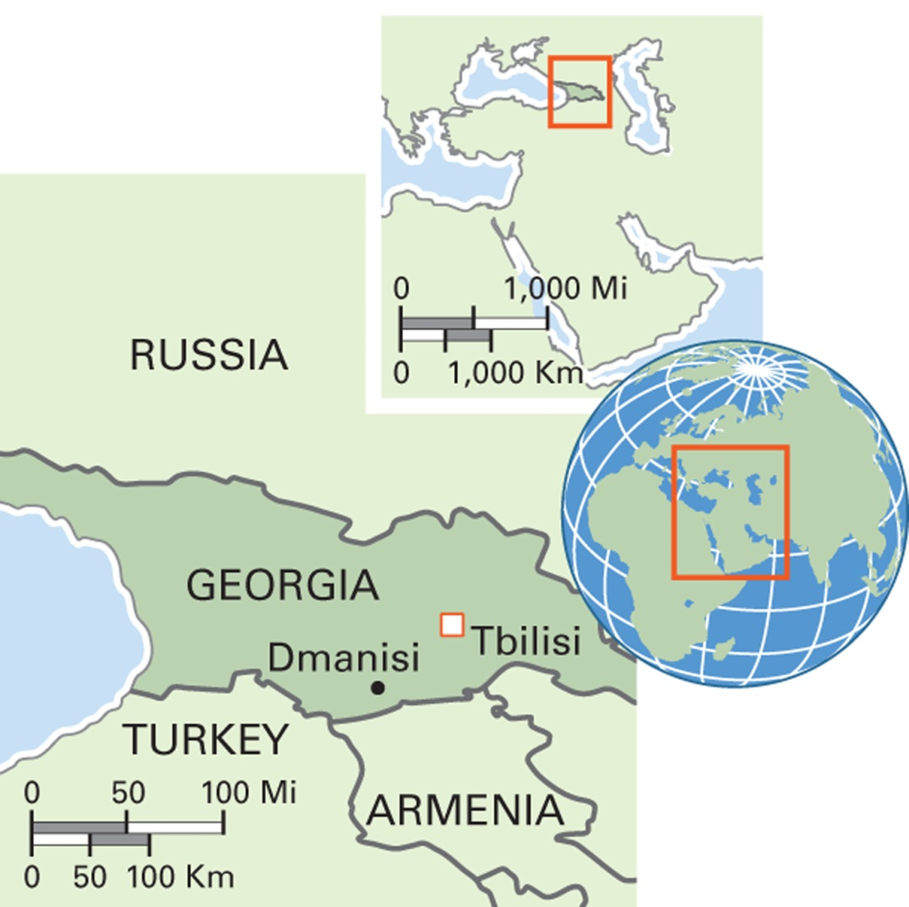
Map 2. 4 Dmanisi, Georgia
Earliest fossil evidence of hominins outside Africa comes from Dmanisi in the Caucasus region of Georgia
1.7 million years ago
Notes:
The country of Georgia has the distinction of being the site of 1.7 million-year-old hominin fossils found at Dmanisi. Many thousands of years later, during the Neolithic era, modern humans first domesticated grapes and produced wine in this region.

Slide 30
The Early Hominins (9 of 13)
The Neanderthals
  Homo neanderthalensis was discovered in Germany
  Known from over 100 sites spread across Europe, into Israel and Iraq, and all the way to Siberia
  Survived from 400,000 to 30,000 years ago
  Compared with modern humans, had heavier limb bones, larger brains, and distinctive facial skeletons

Slide 31
The Early Hominins (10 of 13)
  Able to tolerate the cold temperatures that affected Europe and Northern Asia
  In addition to biological adaptations, also developed cultural adaptations to the cold, including clothing
  Buried their dead and may have believed in an afterlife
  Stone tool kit referred to as the Mousterian tradition: smaller, lighter, and more specialized flake tools
  Had elements of expressive culture

Slide 32
The Early Hominins (11 of 13)
The Neanderthals, debates:
  Did they have the capacity for verbal language?
  Did they go extinct or did they interbreed with modern humans?
    Findings in 2010 indicate they did interbreed and that a small percentage of Europeans and Asians carry Neanderthal genetic material

Slide 33
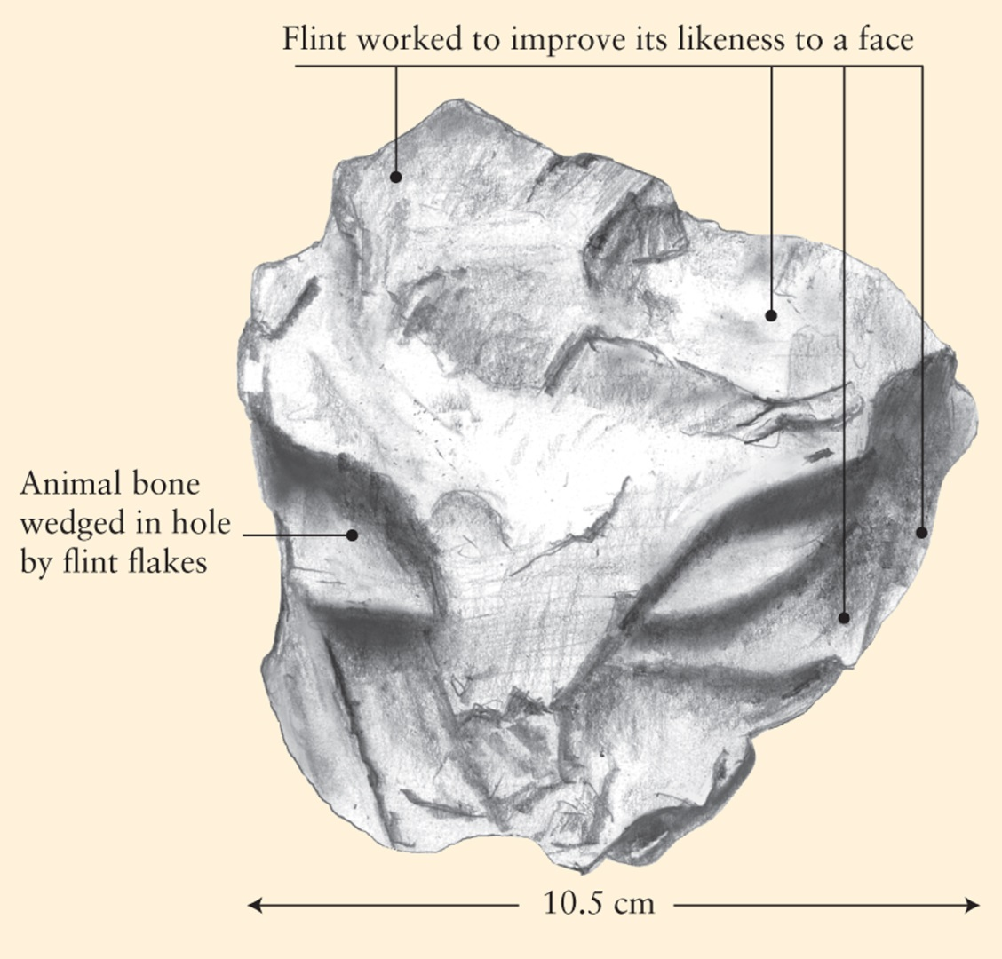
Figure 2.4 Worked Flint Found by the Loire River in Northern France
Neanderthal expressive culture: “face” in worked flint
Notes:
Dated to 35,000 years ago, this object was made by Neanderthals and is one of the earliest examples of sculpture.

Slide 34
The Early Hominins (12 of 13)
Neanderthals survived in a cold climate for many thousands of years through biological and cultural adaptations
With their Mousterian toolkit were able to make “simple” clothing
One theory about their extinction: Their simple clothing could not protect them against spikes of extreme cold weather

Slide 35
The Early Hominins (13 of 13)
Modern humans lacked Neanderthals’ biological adaptations to cold, but they developed technology to produce “complex” clothing
Food for Thought:
  What is your experience, in extremely cold weather, with the effectiveness of close-fitting and layered clothing versus loose-fitting and nonlayered clothing?

Slide 36
Modern Humans (1 of 7)
Anatomically modern humans (AMH)
  Homo sapiens, the species to which modern humans belong
Significant morphological changes
  Steeper foreheads with smaller brow ridges
  Smaller faces
  Smaller incisor teeth
  Thinner limb bones
More elaborate and complex culture

Slide 37
Modern Humans (2 of 7)
Earliest fossil evidence from a site in Ethiopia from 160,000 years ago
Modern tools found in African sites dated to 300,000 years ago
Genetic analysis: All modern humans are descended from a common ancestral population that lived in Africa at least 200,000 years ago

Slide 38
Modern Humans (3 of 7)
The Upper Paleolithic
  The period of modern human occupation in Europe and Eurasia 45,000 to 12,000 years ago
  Technology included microliths and other small, finely made stone and bone tools, nets, and baskets
  A period of rapidly increasing cultural complexity, referred to as a cultural revolution or “Golden Age”

Slide 39
Modern Humans (4 of 7)
Cro-Magnon People
  Archaeologists first discovered fossil evidence for modern humans at Cro-Magnon, a rock shelter site in Les Eyzies, France
  The Cro-Magnon people arrived in Europe around 40,000 years ago
  An impressive legacy of cave art and portable art
  May have had verbal language

Slide 40
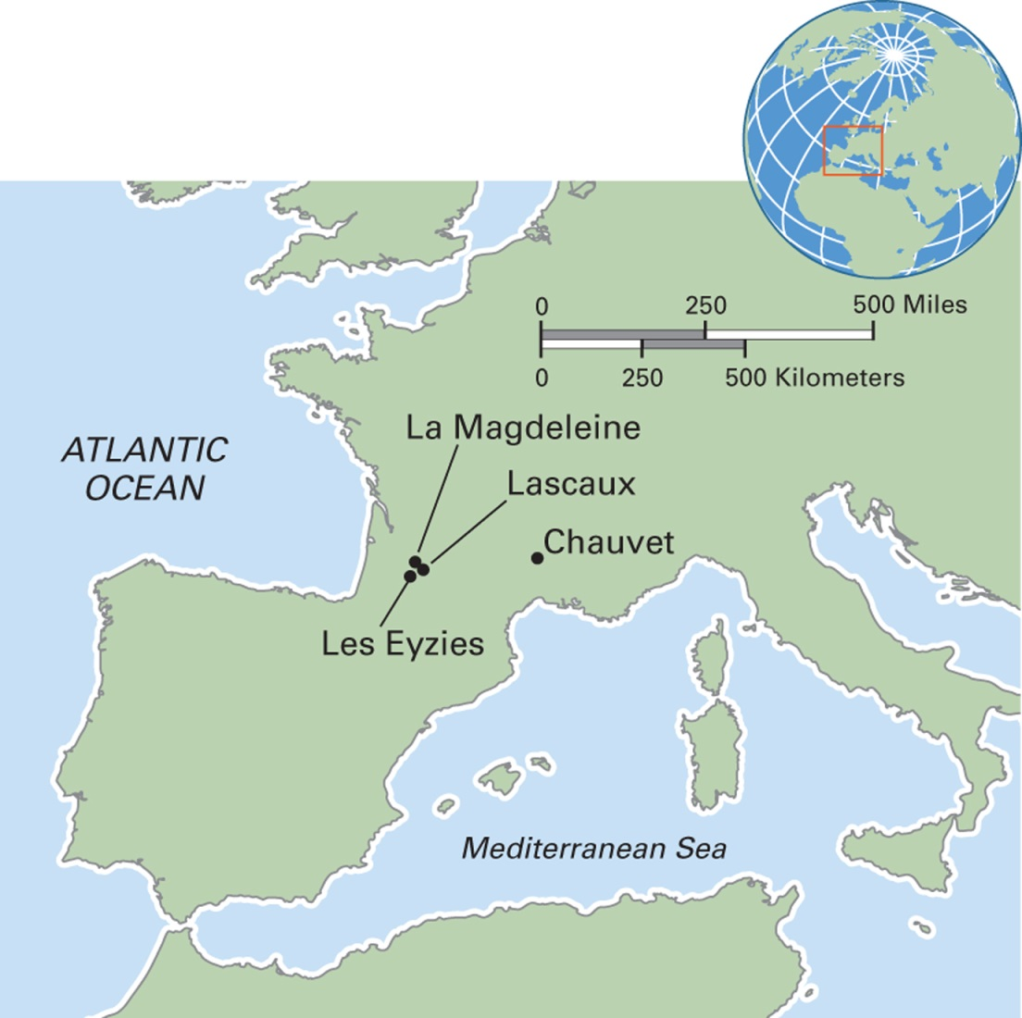
Map 2.7 Upper Paleolithic Sites in Europe
Notes:
This map shows only a small number of the many sites in Europe from the Upper Paleolithic era. Les Eyzies (lay-zay-zee) is the first site where evidence of Cro-Magnons was discovered. Lascaux (lah-SKOH) and Chauvet (shoh-VAY) are two of the most important cave art sites in Europe. La Magdeleine (la-mahd-LEN) is the site for the fourth and last cultural stage of the Upper Paleolithic. At French Magdalenian sites, the main food source of modern humans was reindeer. At Magdalenian sites in Germany and Russia, evidence exists that people had domesticated dogs, perhaps for hunting.

Slide 41
Modern Humans (5 of 7)
Modern Human Migrations into the New World
  Modern humans began migrating from Siberia to present-day Alaska 30,000 years ago
  Within a few thousand years had migrated throughout most of North America and into Central and South America
  An alternate theory proposes Europe as a source of migration

Slide 42
Modern Humans (6 of 7)
The Clovis People
  Based on archaeological evidence, the first modern humans in the New World
  Characterized by the Clovis point, which is bifacial and fluted
  Oldest sites are dated to 11,000 years ago
  Clovis culture was short-lived

Slide 43
Modern Humans (7 of 7)
Pre-Clovis Sites
  Recent claims for pre-Clovis sites indicate a human presence in South America 12,500 years ago
  Monte Verde, Chile, is the most definite of the possible pre-Clovis sites
  Genetic data recovered in Oregon (Paisley Caves) proves the existence of modern humans in North America around 12,300 years ago

Slide 44
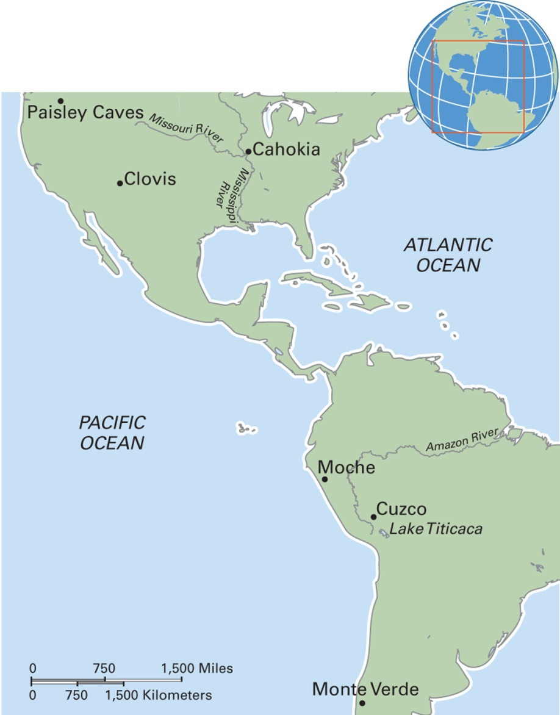
Map 2.8 New World Sites

Slide 45
The Neolithic Revolution and the Emergence of Cities and States
2.3 Summarize how modern human culture has changed in the past 12,000 years.
The Neolithic Revolution
Cities and States

Slide 46
The Neolithic Revolution (1 of 5)
A time of rapid transformation in technology related to plant and animal domestication
Developed tools such as sickle blades and grinding stones
Began in the Old World in Mesopotamia, especially the Fertile Crescent

Slide 47
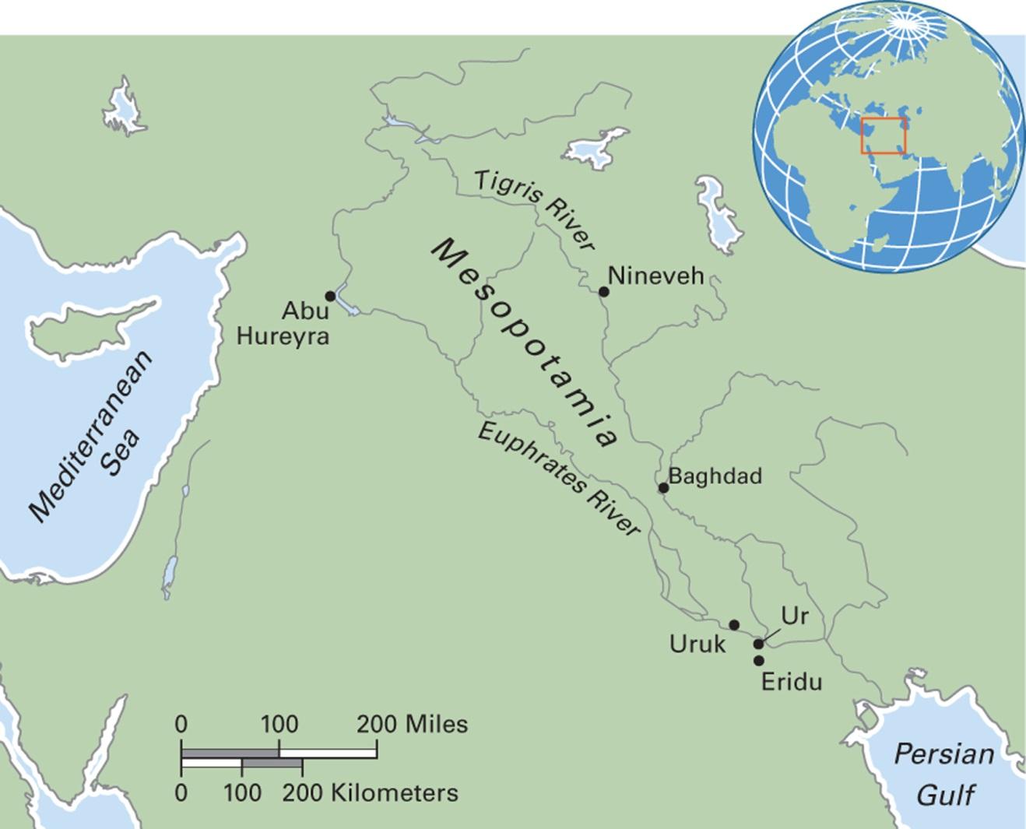
Map 2.10 Neolithic Sites in the Middle East
Notes:
Archaeologists have excavated many important Neolithic sites in the Middle East, including those mentioned in this chapter and shown here. In much of the Middle East and North Africa, Neolithic sites have been damaged as the result of recent and ongoing political violence.

Slide 48
The Neolithic Revolution (2 of 5)
Abu Hureyra
  Neolithic site located near the Euphrates
  A tell: human-made mound resulting from the accumulation of successive generations
  Occupied from 10,500 to 6000 BCE
  Stratigraphy of the tell provides the story of change during the Neolithic

Slide 49
The Neolithic Revolution (3 of 5)
The Neolithic in Europe
  In Africa’s Sahel, the grassland regions south of the Sahara desert, a different pattern of domesticates emerged
  Foragers for thousands of years, combining fishing, hunting herd animals, and harvesting wild grasses
  Domestication of cattle was the first step in the transition to the Neolithic in Africa

Slide 50
The Neolithic Revolution (4 of 5)
The Neolithic in Europe
  Relied on the introduction of plant and animal domesticates from the Middle East
  The first domesticates appeared in southeastern Europe around 6000 BCE
  Archaeological evidence for the later Neolithic shows social status differences, group ceremonies and feasts, and religious sites

Slide 51
The Neolithic Revolution (5 of 5)
Domestication in the New World
Began in Middle America (or Mesoamerica)
Three distinguishing features:
  The first experiments with domesticated plants took place before sedentism
  The first domesticated plants were gourds, squash, beans, and maize, and the first animal domesticates were dogs, turkeys, and honey bees
  The transition to an entirely agricultural way of life was slower than in the Middle East, extending from 8000 to 2000 BCE

Slide 52
Cities and States (1 of 4)
A city is distinguished by having
  A larger population (more than 10,000 people)
  More occupational specialization
  More elaborate architecture
  Central services
A state is a centralized political organization encompassing many communities
States have the power to levy taxes, keep the peace through the use of force, and wage war

Slide 53
Cities and States (2 of 4)
Cities and States in the New World
  Formed later than in the Old World
  Though powerful and extensive, did not have writing
  Had elaborately constructed capital cities, lavish political feasting, competitive sports, and wealth
  Example: Moche civilization, emerged around 200 BCE in Peru

Slide 54
Cities and States (3 of 4)
Cities and States in North America
  Although complex societies emerged, they did not develop state-level institutions but remained as complex chiefdoms
  Mississippian cultures, dated to the first century CE, developed important trade centers
  Example: Cahokia

Slide 55
Cities and States (4 of 4)
Civilizations are not forever
  All past states have gone through cycles of expansion and decline followed by the rise of new states
  Why do states collapse?
    Difficulty of maintaining territory and extreme social inequality of long periods
    Environmental decline that accompanies state building and accumulation
    Anthropogenic effects on the environment contributed to the collapse of many great and powerful civilizations

